Slide 1
Neha Goud Baddam
COVID-19 infection inference with graph neural networks
Kyungwoo Song, Hojun Park, Junggu Lee, Arim Kim & Jaehun Jung
Nature Scientific Report

Slide 2
Introduction
Coronavirus disease (COVID-19) is an infectious disease caused by the SARS-CoV-2 virus.
COVID-19 Impact:
Rapid global spread since December 2019.
Affects all aspects of life: social, physical, environmental, and economic.
Specially for diseases like COVID-19
Urgency in identifying high-risk transmitters to control the spread.
Importance of Epidemiological Surveys
Epidemiology is a branch of medical science that studies the distribution, patterns, and causes of health and disease in a defined population.
Identifying at-risk individuals.
Reducing transmission rates.
Need for Automation
And with advancements in computational medicine, there is a need to automate this process.
Manual surveys are labor-intensive and time-consuming.
Automated tools can:
Reduce the burden on epidemiologists.
Increase speed and efficiency of epidemiological investigations.

Slide 3
Introduction
Problem Statement:
Infectious diseases spread rapidly.
Epidemiological surveys are crucial to identifying high-risk transmitters.
Need for automatic tools to assist epidemiologists.
Research Objective
Develop an automatic epidemiological survey tool.
Use Graph Neural Networks (GNNs) to predict whether a confirmed case will influence future infections.
Focus on real-time applications for prediction without future contact information.

Slide 4
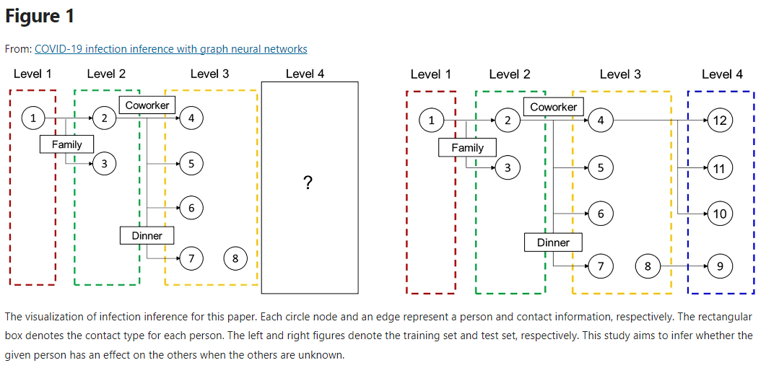
Introduction

Slide 5
Dataset
Incheon City COVID-19 Infection Network Data
1,678 people
183 graphs
Key Dataset Features
Infection order (1st, 2nd, 3rd, etc.)
Example: A infects B (2nd order), B infects C (3rd order).
Gender
Age
Symptom-related data

Slide 6
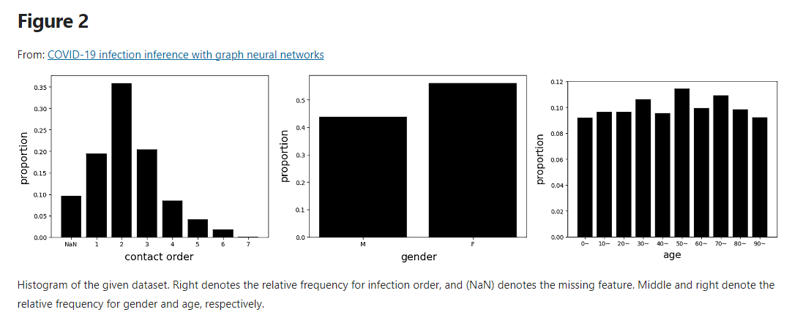
Dataset

Slide 7
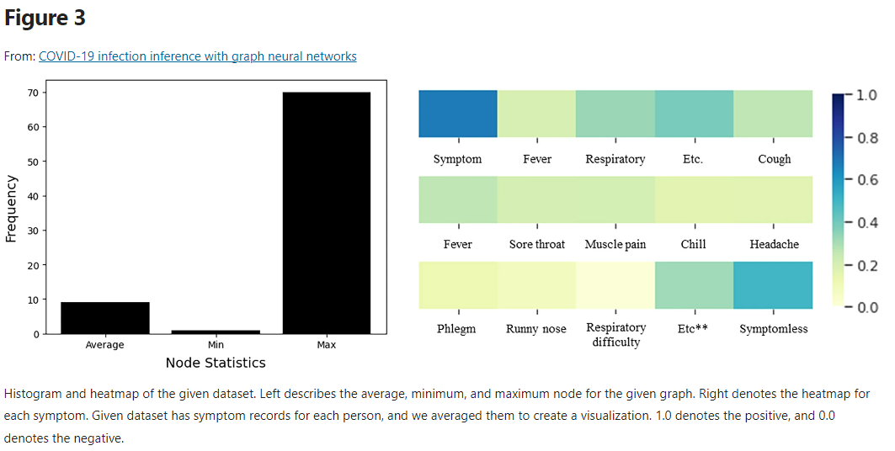
Dataset
Graph Statistics:
Average graph size: 9.16 nodes. Each graph shows diverse spreading patterns and infection routes.
Follows the power law, with the degree distribution: P(k) ~ k^(−1.798).
This indicates that a few people have many contacts in this infection network, while most people have only a few.

Slide 8
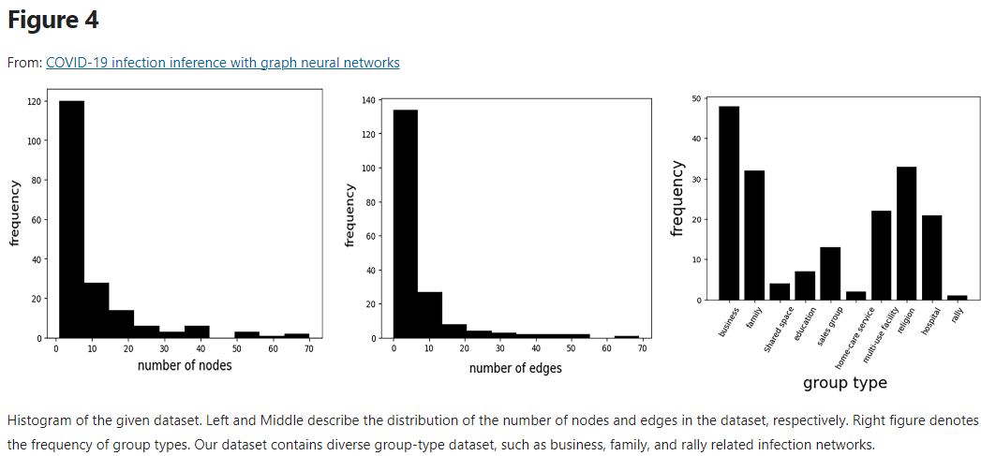
Dataset

Slide 9
Pre-Processing
Feature Conversion:
Gender:
Male = 0, Female = 1.
Age:
Birth year before 1982 = 0.
Birth year after 1982 = 1.
Handling Missing Data and Small Graphs
Removed instances with missing values.
Excluded small graphs with fewer than 3 nodes.
Prediction Setup
Goal: Predict whether a person will infect others (nth-order infection).

Slide 10
Methods
GNNs Overview:
A framework to handle graph-structured data.
Learn node and edge embeddings to reflect graph properties.
Homophily assumption: Similar nodes tend to connect.
Message Passing and Readout Phases
Message Passing:
Information flows between a node and its neighbors.
Readout Phase:
Aggregates the information from the message-passing phase.
Operates on first-order neighborhoods (direct neighbors).
GNN Layers
To capture multi-order neighborhoods, GNNs are stacked deeper.
This allows information to flow across broader network regions.

Slide 11
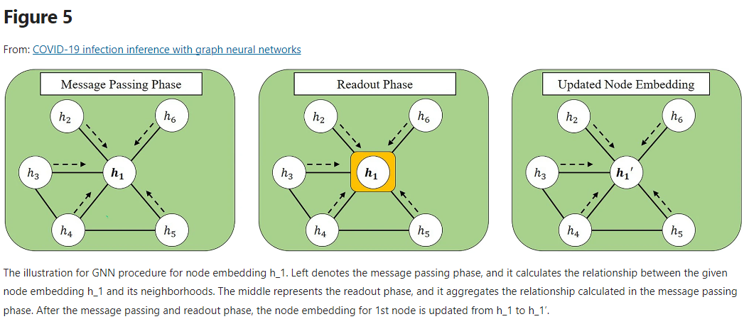
Methods

Slide 12
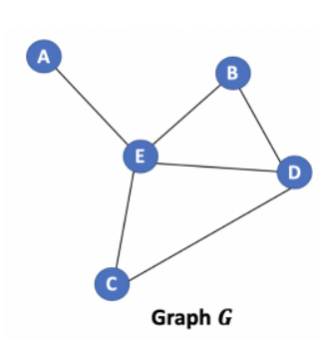

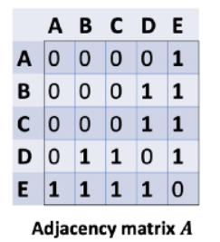
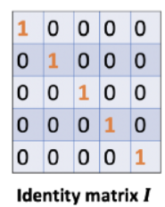
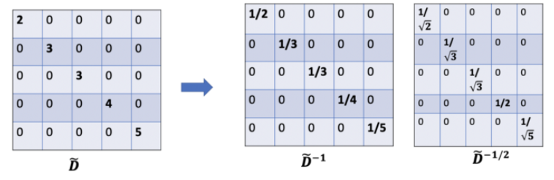
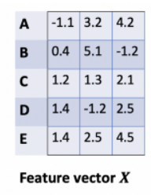
Methods
Graph Convolutional Networks (GCNs)
They use spectral graph convolution to gather neighborhood information.
Each node in the graph has its own feature vector.
The adjacency matrix A defines which nodes are connected to each other.
For each node, we want to aggregate the features of its neighbors. This is done by multiplying the feature matrix h by the normalized adjacency matrix D−1/2AD−1/2, which effectively sums up the neighboring features and normalizes them ensuring appropriate contribution from each node.
After aggregating the neighbor's information, we apply the weight matrix W, which allows the model to learn the importance of different features and how to combine them.

Slide 13
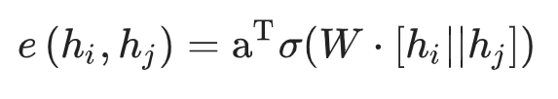
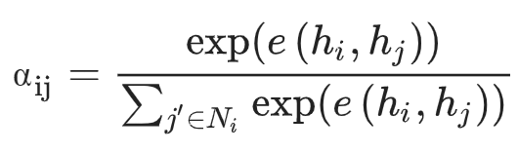
Methods
Graph Attention Networks (GATs)
GAT computes the attention logits (raw attention scores) between nodes i and j, denoted as e(hi,hj).
Each node is represented by an embedding vector (feature vector), hi​ for node i and hj for node j.
To compute these logits, GAT concatenates the embedding vectors of both nodes and applies a linear transformation using a weight matrix W. The formula looks like this:
Once the raw attention score e(hi,hj) is computed, GAT applies a softmax function to convert these scores into attention weights αij​. These attention weights are normalized across all neighbors of node iii so that they sum to 1.

Slide 14
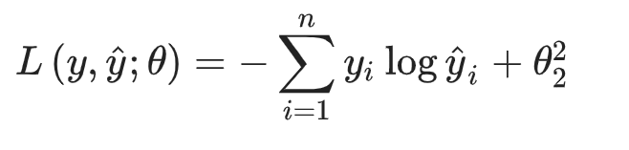
Methods
Classification Task
Classify whether a node (infected person) affects the next round of infection using a simple linear classifier.
Loss Function:
Cross-entropy loss used to compare:
Ground-truth label: actual infection spread
Predicted label: influence of node on future infection
L2 Regularization
The L2 regularization term penalizes large model weights to encourage simplicity and prevent overfitting.
During training, the model learns to adjust the weights to minimize the loss function. This is done through backpropagation.

Slide 15

Results
Baseline Methods
Compare graph-based models (GCN, GAT) with traditional non-graph-based models.
Logistic Regression (LR)
Support Vector Machine (SVM)
Neural Networks (NN)
Experimental Results
Predict whether an nth-order infected person affects the (n+1) th-order infection.
Set n to 2, 3, and 4 to explore different infection scenarios.
Evaluation Metrics
Accuracy (Acc.)
Area Under the Curve (AUC): Plots the True Positive Rate (TPR) against the False Positive Rate (FPR)
F1 Score: Harmonic mean of precision and recall

Slide 16
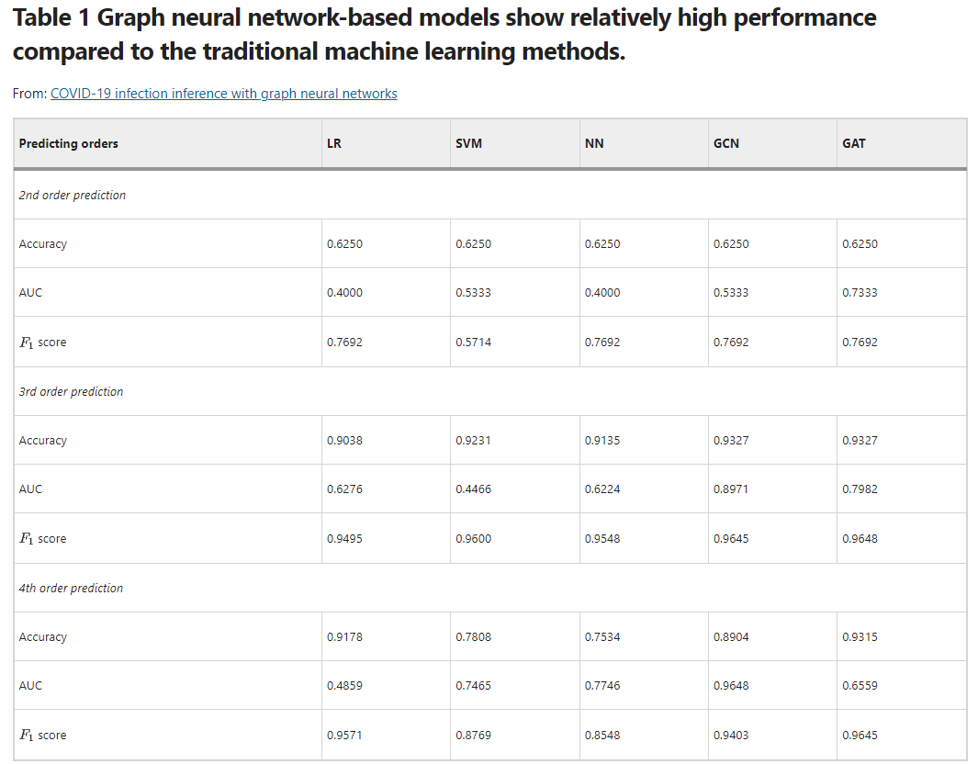
Results

Slide 17
Results
Results Summary:
GCN and GAT outperform LR, SVM, and NN.
Graph-based methods show superior performance in higher-order predictions.
Performance by Order
2nd Order:
Limited graph-structured information.
All models show less competitive results.
3rd and 4th Orders:
Graph-based methods significantly improve their performance.
4th Order:
87.5% of graphs are fully predicted accurately.
Remaining 12.5% partially predicted.

Slide 18
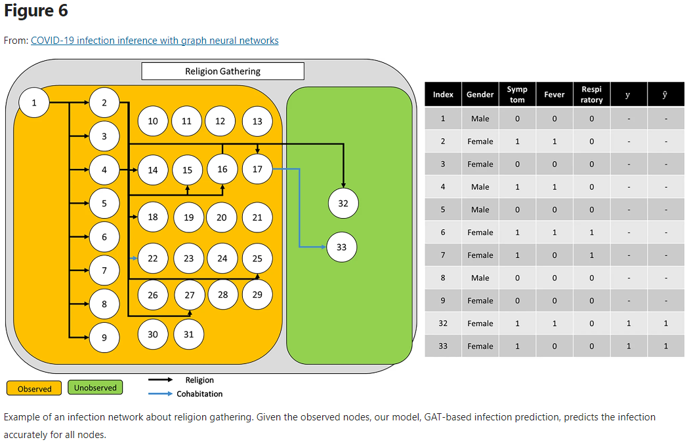
Results
Fig. 6, shows infection networks and node properties.
Highlights effectiveness in predicting additional confirmed cases.

Slide 19
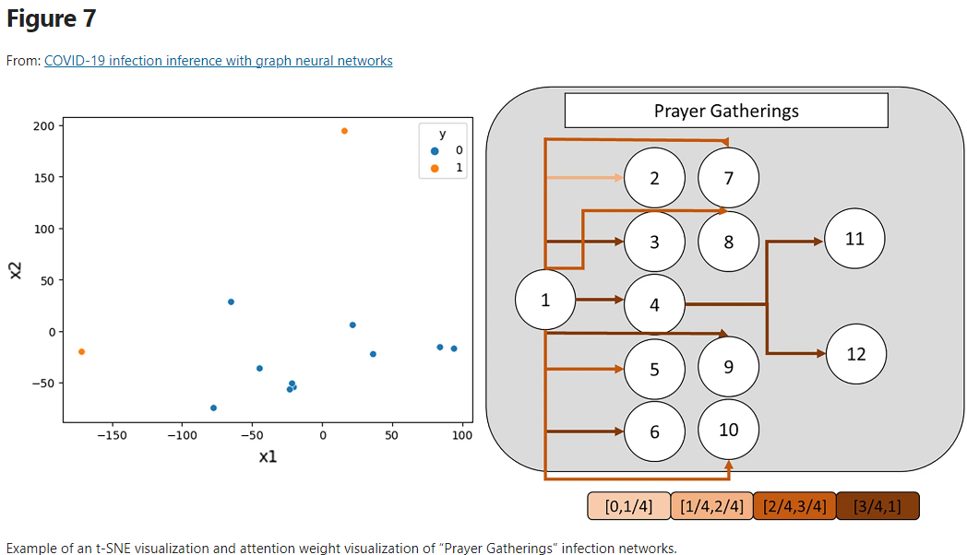
Results
Visualization of Attention Weight :
Visualizes learned node embeddings.
Weights vary dynamically based on node and graph properties. Figures 7, illustrate these variations.

Slide 20
Discussion
Pandemic Context:
COVID-19 continues to rise, causing significant social and economic damage.
Effective strategies are essential for controlling and reducing infection rates.
Study Objective:
Predict future infections using relationship maps from epidemiological surveys.
Utilized GCN and GAT (GNN variants) and compared with traditional models (LR, SVM, NN).
Key Findings:
Graph-Based Models (GCN & GAT): Show superior performance over traditional models.
Advantages: Better in higher-order predictions (3rd, 4th orders).
Data Utilized: Relationship maps and time-invariant features like symptom records enhance prediction accuracy.

Slide 21
Limitations
Based on a limited dataset.
Does not account for virus mutations.
Challenges in capturing long-term time-varying features.

Slide 22
conclusion
Future Directions:
Explore temporal graph neural networks and updatable models.
Aim for larger-scale experiments and improved model interpretability.
Conclusion:
The developed model predicts future infection influence based on past contact information.
Can assist in determining quarantine measures.

Slide 23

Questions?

Slide 24
Thank You!

